Slide 1

FACULTY: ITIF GROUP: 604.20E TEACHER: SEVINJ KARIMOVA STUDENT: GUNEL HUMBATOVA SUBJECT: COMPUTER ARCHITECTURE
AZERBAIJAN
STATE
OIL
AND
INDUSTRY
UNIVERSITY

Slide 2
Memory. Memory Organization and Addressing

Slide 3
1. WHAT IS MEMORY? 2. MEMORY HIERARCHY 3. MAIN MEMORY 4. AUXILIARY MEMORY 5. ASSOCIATIVE MEMORY 6. CACHE MEMORY 7. VIRTUAL MEMORY
PLAN

Slide 4

WHAT IS MEMORY?
Computer memory is any physical device capable of storing information temporarily, like RAM (random access memory), or permanently, like ROM (read-only memory). Memory devices utilize integrated circuits and are used by operating systems, software,
and hardware.

Slide 5
MEMORY
MEMORY
HIERARCHY
MAIN
MEMORY
AUXILIARY
MEMORY
ASSOCIATIVE
MEMORY
CACHE
MEMORY
VIRTUAL MEMORY

Slide 6
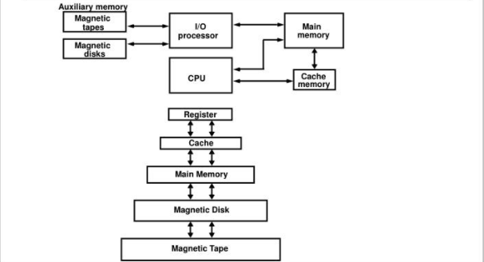
MEMORY HIERARCHY
Memory Hierarchy is obtain the highest possible access speed while minimizing the total cost of the money system

Slide 7
Main memory is where programs and data are kept when the processor is actively using them. When programs and data become active, they are copied from secondary memory into main memory where the processor can interact with them. ... Main memory is sometimes called RAM. RAM stands for Random Access Memory
MAIN MEMORY

Slide 8
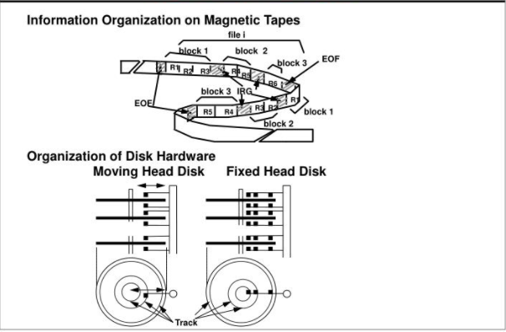
Auxiliary memory units are among computer peripheral equipment. They trade slower access rates for greater storage capacity and data stability. Auxiliary memory holds programs and data for future use, and, because it is nonvolatile (like ROM), it is used to store inactive programs and to archive data.
AUXILIARY MEMORY

Slide 9
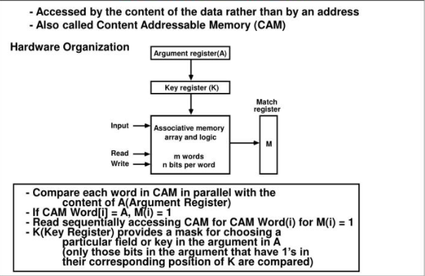
An associative memory can be considered as a memory unit whose stored data can be identified for by the content of the data itself rather than by an access address or memory location. Associative memory is often referred to as Content Addressable Memory (CAM).
ASSOCIATIVE MEMORY

Slide 10
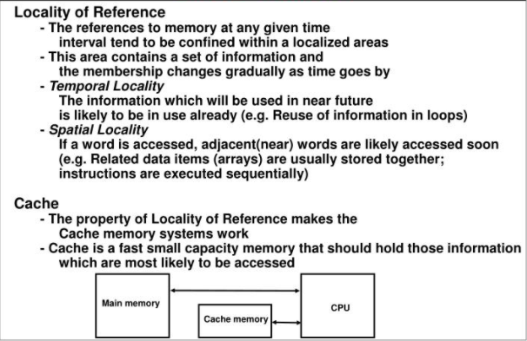
Cache memory is an extremely fast memory type that acts as a buffer between RAM and the CPU. It holds frequently requested data and instructions so that they are immediately available to the CPU when needed. Cache memory is used to reduce the average time to access data from the Main memory.
CASH MEMORY

Slide 11
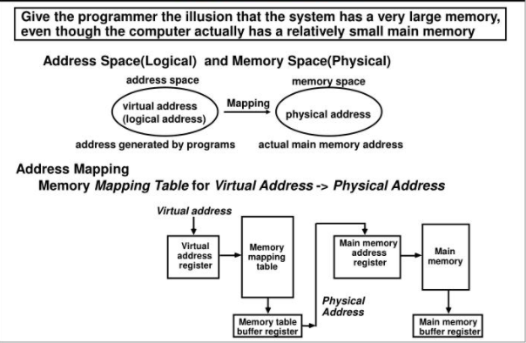
Virtual memory is a feature of an operating system that enables a computer to be able to compensate shortages of physical memory by transferring pages of data from random access memory to disk storage. ... This means that when RAM runs low, virtual memory can move data from it to a space called a paging file.
VIRTUAL MEMORY

Slide 12
MEMORY ADDRESSING
A memory address is a unique identifier used by a device or CPU for data tracking. This binary address is defined by an ordered and finite sequence allowing the CPU to track the location of each memory byte.
Modern computers are addressed by bytes which are assigned to memory addresses – binary numbers assigned to a random access memory (RAM) cell that holds up to one byte. Data greater than one byte is consecutively segmented into multiple bytes with a series of corresponding addresses.

Slide 13
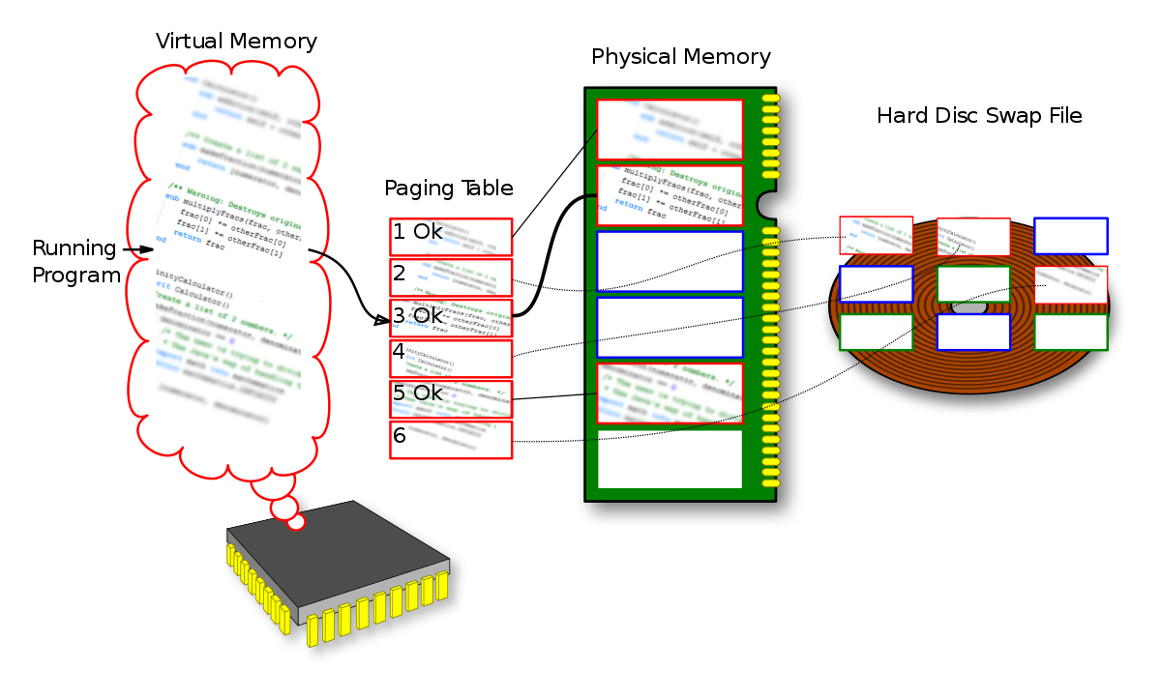

Slide 14
RECOURCES
https://www.
techopedia.com/definition/323/memory-address
https://www.
computerhope.com/jargon/m/memory.htm
https://
en.wikipedia.org/wiki/Virtual_memory
https://www.
slideserve.com/kelda/memory-organization-powerpoint-ppt-presentation

Slide 15
THANKS!

